Slide 1

“Smart Real Time Battery Monitoring System”
GUIDED BY :- Prof. Shripad Deshpande
SUBMITTED BY :-
1) Akshay Navale
2) Ganesh Karande
3) Saurav Mishra
4) Ashish Kannaujiya
Centre for Development of Advanced Computing (C-DAC), ACTS Pune(411008)

Slide 2

0
Why Real Time Operating System?

Slide 3
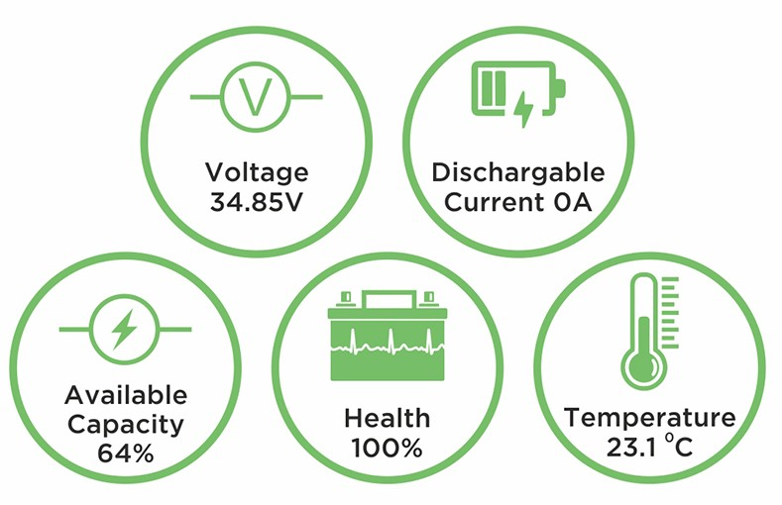
Introduction
Importance of Battery Monitoring:
Batteries play a crucial role in powering diverse applications.
Monitoring their performance is key to ensuring reliability and efficiency.
Real-Time Monitoring Demand:
With the rise of dynamic technologies like IoT and electric vehicles,
the need for instant battery data has grown significantly.
Enhancing Efficiency:
Real-time monitoring allows for quick responses, enhancing the overall efficiency of systems.

Slide 4
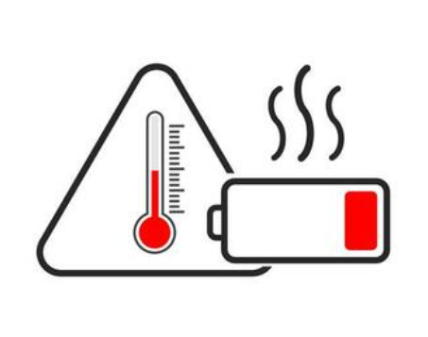
Objective
At which point where battery heats most, over-current and under voltage.
Monitoring over current, low voltage, temperature rise.
Overheating, Overcurrent, Low Voltage Warning !
Disconnect the battery from the circuit and Alarm activation .
Reconnect the battery to the circuit.

Slide 5
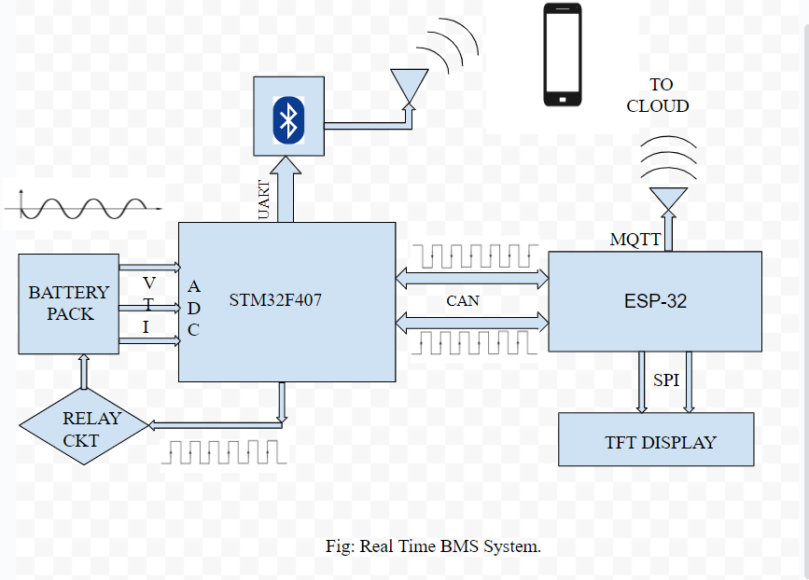
Block Diagram

Slide 6
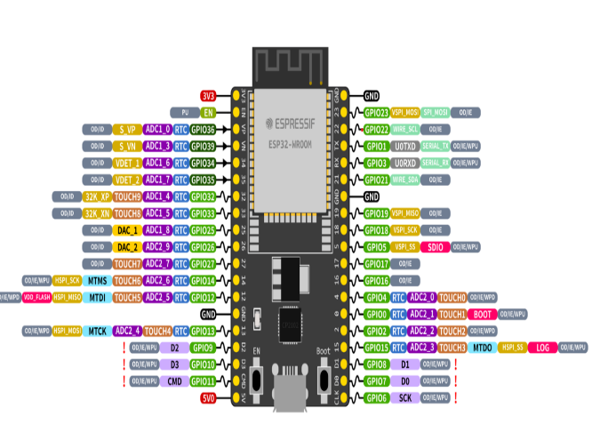
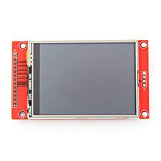
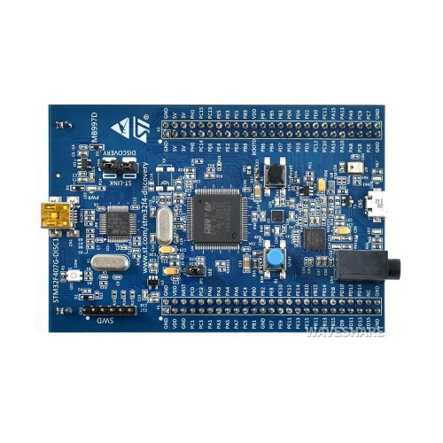
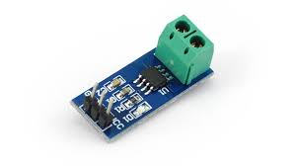

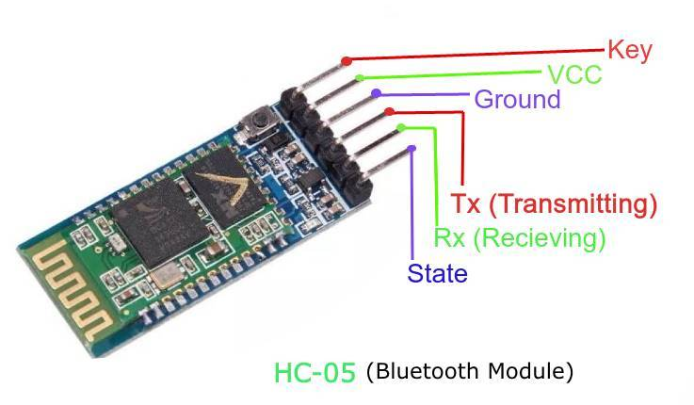
Hardware components

Slide 7
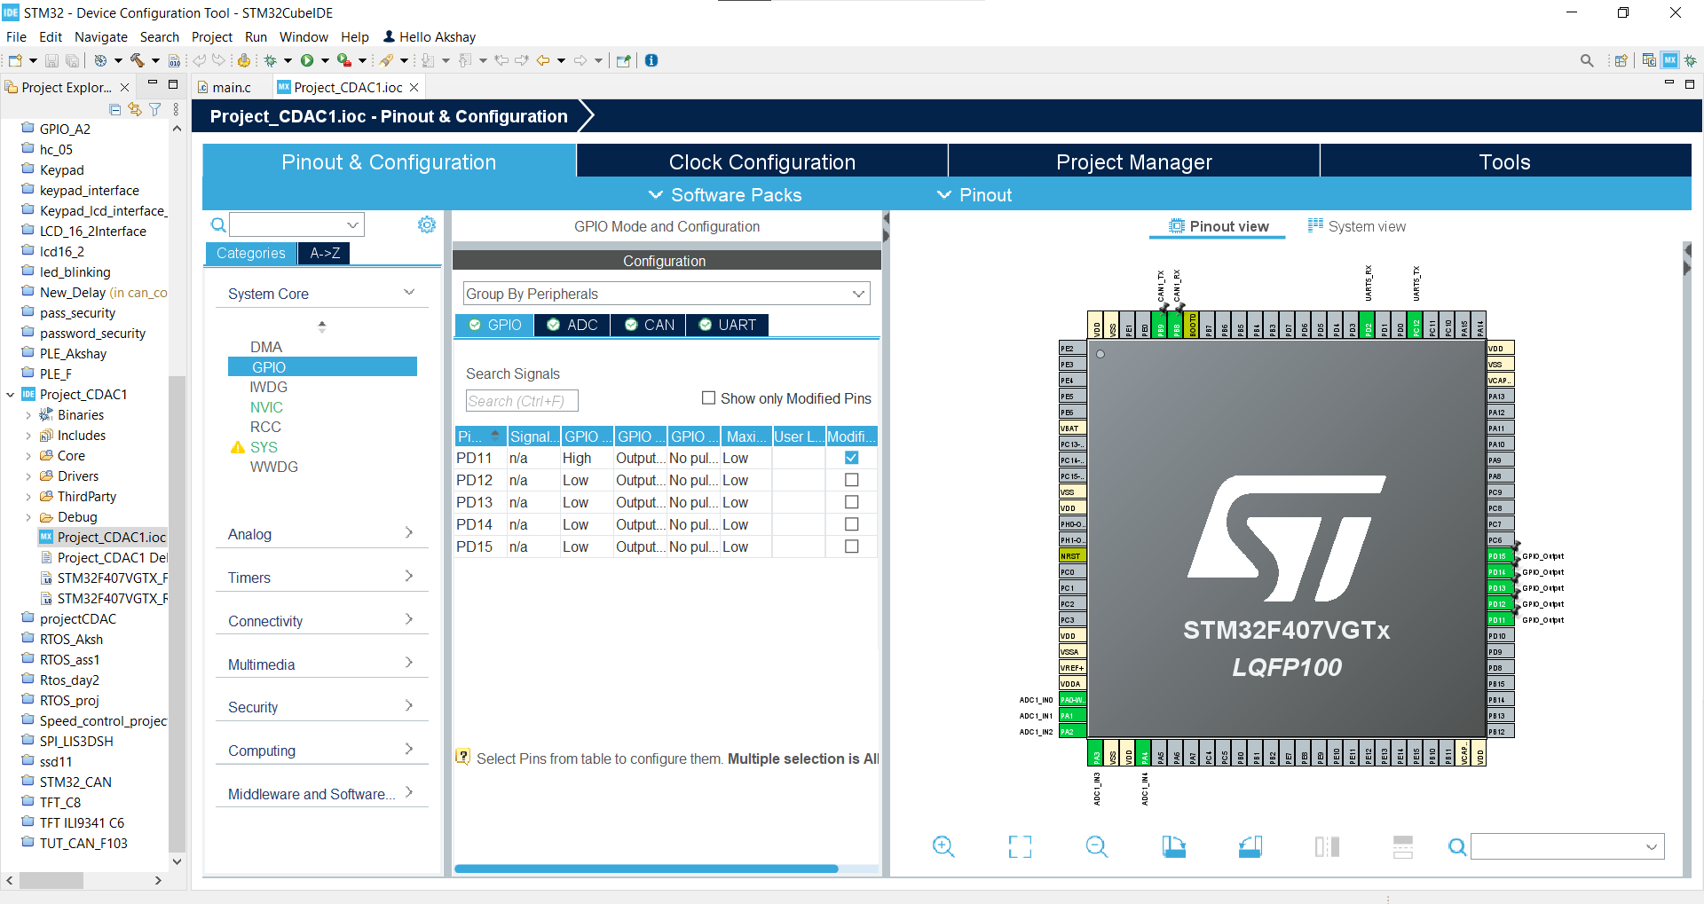
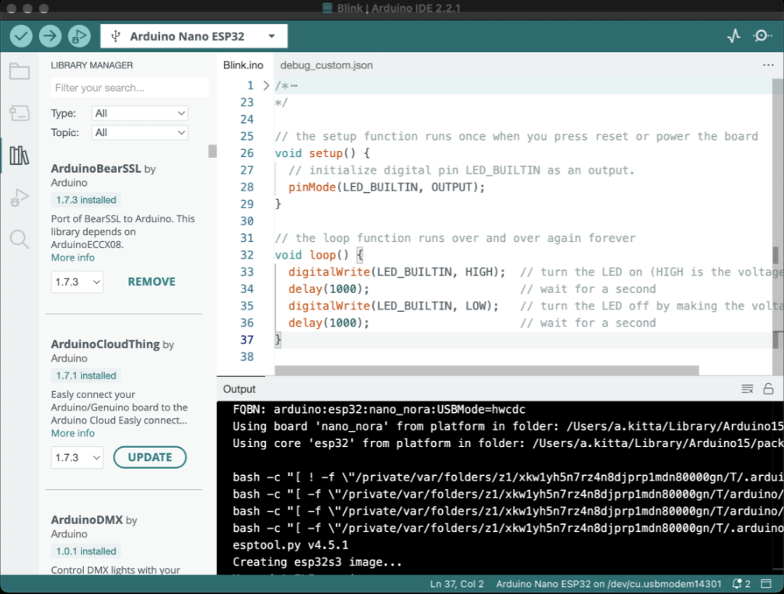
Software

Slide 8

Circuit Diagram

Slide 9
Working
Microcontroller: Utilize the 12-bit ADC of the STM32F407VGT6 microcontroller with FreeRTOS for precise analog-to-digital conversion, ensuring accurate processing of sensor data, including critical battery parameters such as voltage, current, and temperature in real-time.
Establish communication with IoT cloud platforms by integrating the ThingBoard platform and MQTT broker, ensuring seamless data transmission.
Communication Protocols: Provide an overview of the CAN, UART, SPI protocols in the context of battery monitoring systems.
IOT Platform:MQTT facilitates communication between the battery monitoring system on cloud platforms.

Slide 10
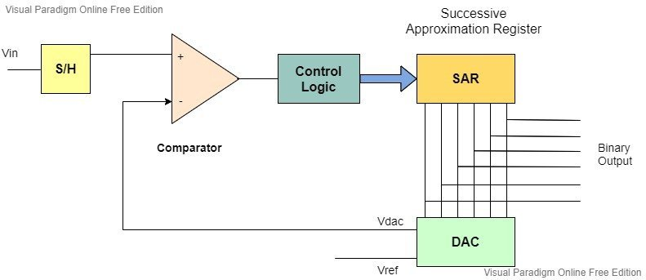
Signal Conditioning

Slide 11

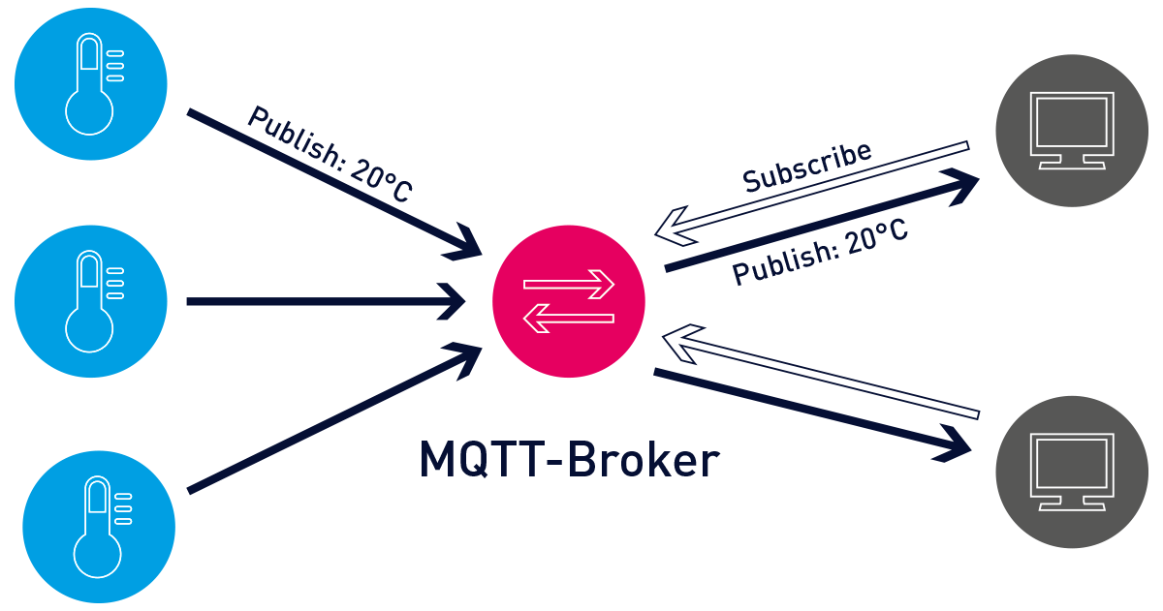
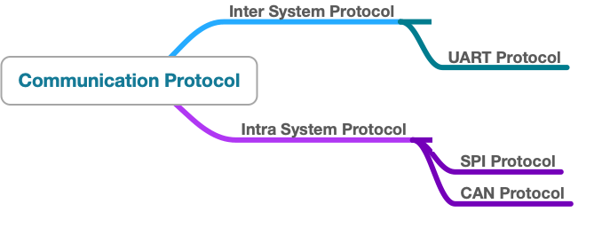
Communication Protocols

Slide 12
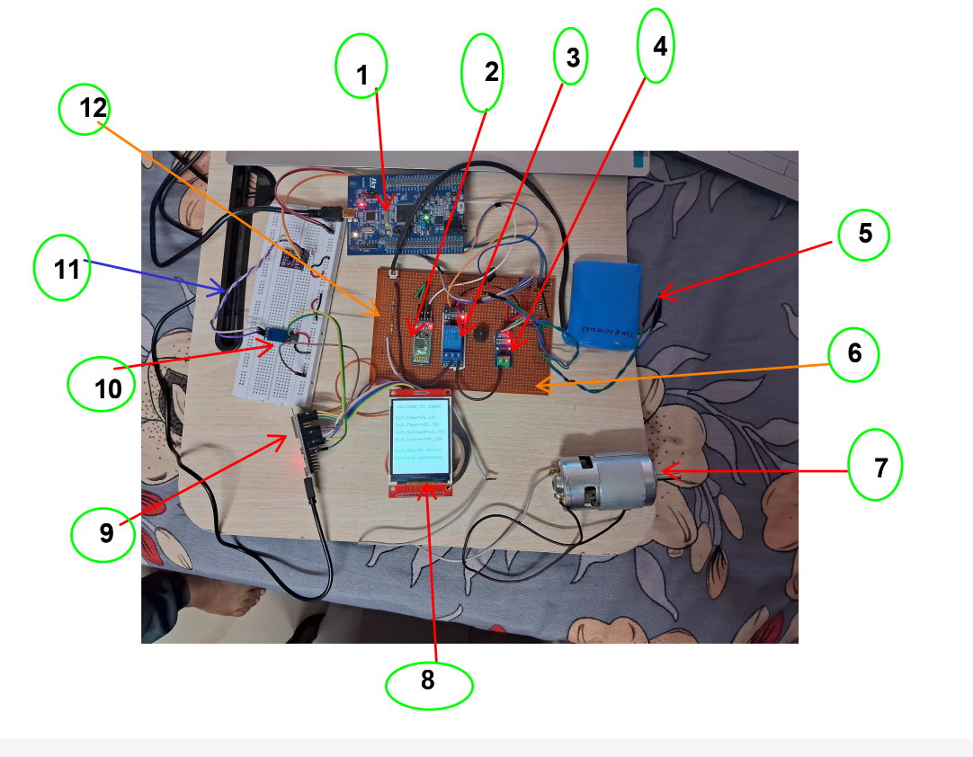
Output

Slide 13
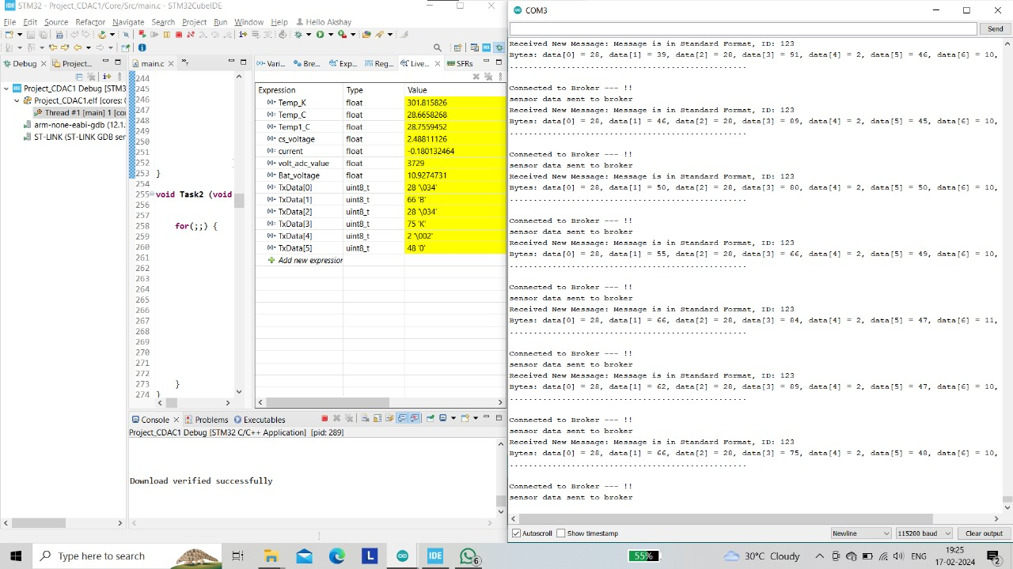
Real-Time Monitoring

Slide 14
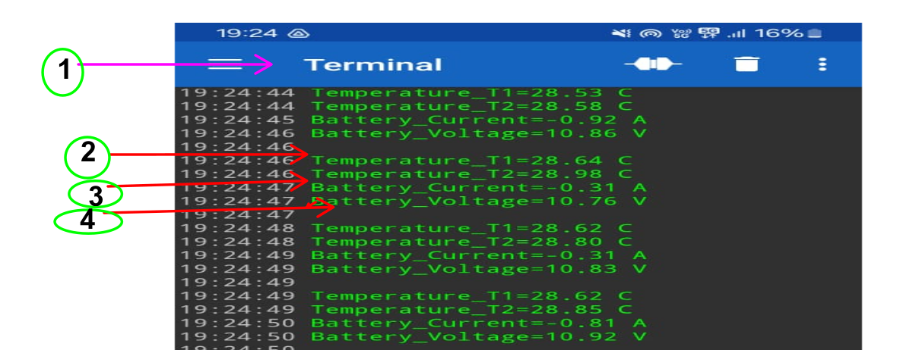
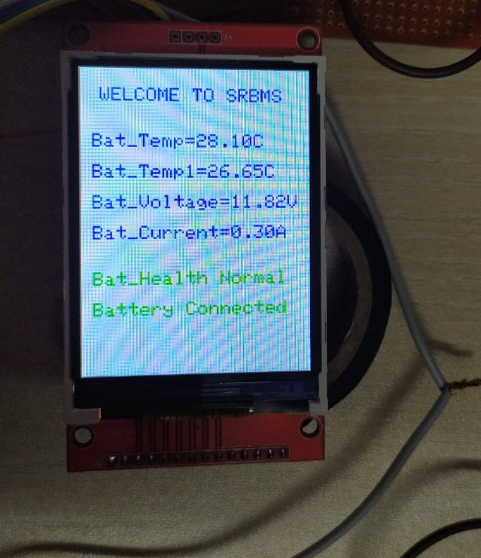
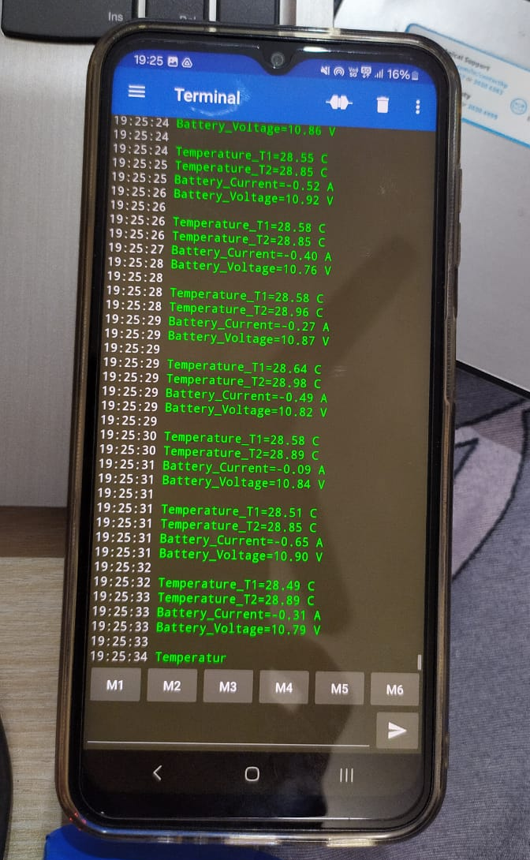
Data visualization on Smartphone and Display

Slide 15
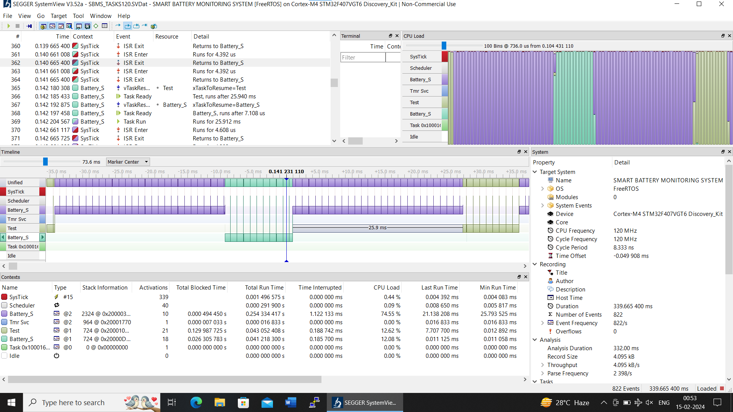
Task Timing Diagrams

Slide 16
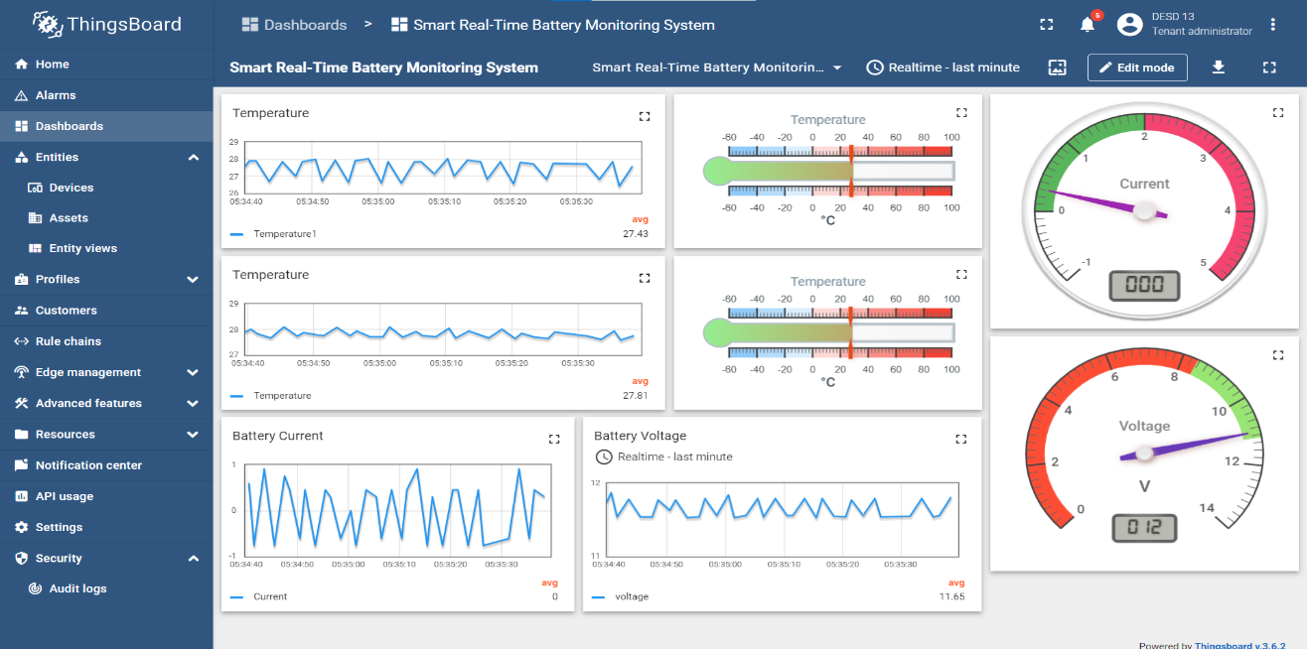
Data Monitoring on Cloud

Slide 17
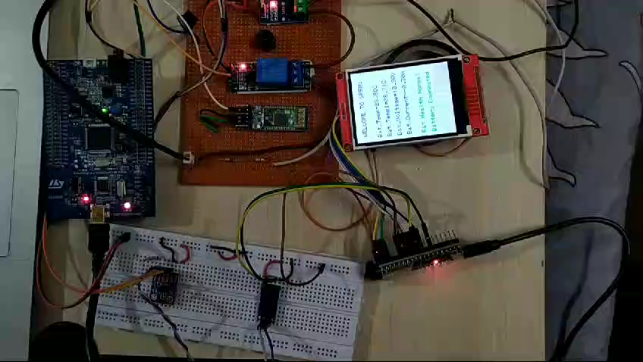
Visualization Demo

Slide 18
Advantages
Real-Time Monitoring: The project enables real-time monitoring of crucial battery parameters, allowing for prompt response to changes and potential issues.
Integration of Communication Protocols: The use of CAN, UART, SPI, MQTT, and the integration of ESP32-WROOM-32D provide versatile and efficient communication options, facilitating
STM32F407VGT6 Microcontroller: Leveraging the 12-bit ADC of the STM32F407VGT6 ensures accurate analog-to-digital conversion, contributing to precise data processing.
IoT Cloud Integration: Connecting to the ThingBoard platform and MQTT broker enables seamless data transmission to IoT clouds, enhancing accessibility and analysis of battery performance remotely.
User-Friendly Interface: The development of a user-friendly interface allows for easy configuration and monitoring, enhancing the overall user experience.
Fault-Tolerance: Incorporating fault-tolerant mechanisms ensures the system's robustness by addressing unexpected events or errors effectively.

Slide 19
Disadvantages
Power consumption: Some monitoring systems might drain a small amount of battery power themselves.
Wireless systems: If using wireless monitoring, signal interference and limited range can hinder data transmission.

Slide 20
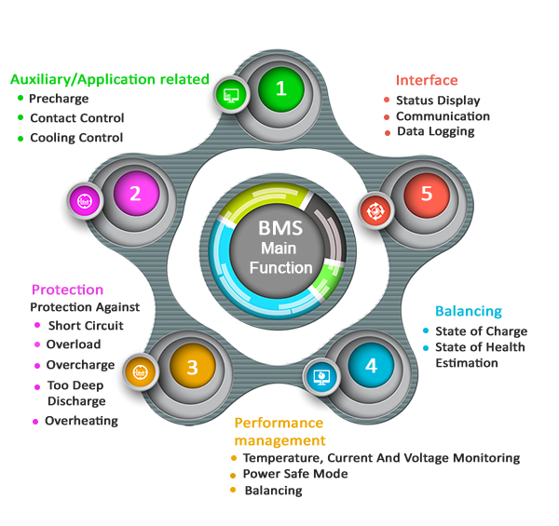
Future scope & Application

Slide 21
Conclusion
Enhanced Battery Safety:
Real-time monitoring prevents hazards by addressing over-temperature, low voltage, and current issues, ensuring battery safety.
FreeRTOS Task Management:
FreeRTOS OS efficiently manages tasks, crucial for real-time monitoring of battery parameters.
CAN-Based Communication:
Utilizing the CAN protocol enables seamless data transfer from STM32 to ESP32, facilitating communication with Thingsboard.
Critical Data Protection:
System focus on monitoring critical battery parameters safeguards human life and prevents economic losses.
Deterministic Operation with RTOS:
Implementation of Real-Time Operating System ensures time-critical responses, enhancing system reliability and performance.

Slide 22

Smart Real Time Battery Monitoring System

